Slide 1
AUXILIARY VERBS

Slide 2
verbs
A verb is the part of speech that expresses action, condition, or being. Verbs change form to indicate person, number, tense, voice, and mood.
Main verb/ primary verb
Helping verb/ Auxiliary verb
The main verb of a sentence is often preceded by one or more auxiliary or helping verbs, which together form a complete verb.
Eg) I might come.

Slide 3
AUXILIARY VERBS
In English, there are two types of auxiliary verbs.
Primary auxiliaries
Modal auxiliaries.

Slide 4
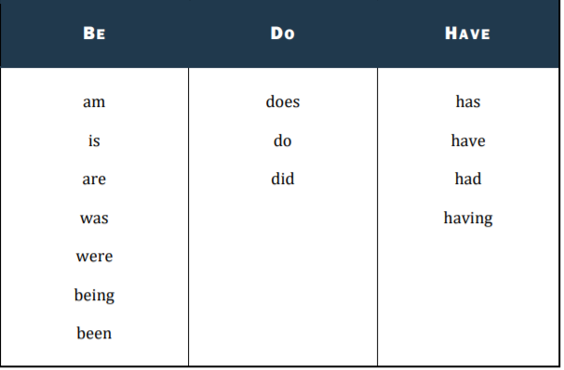
Primary auxiliary verbs

Slide 5
Primary auxiliaries change their form according to the number and person of the subject.
He is writing. They are writing. We are writing. I was writing
It is important to know that these verbs (do, have and be) can also occur as action words or linking verbs. If the verb stands alone in a sentence, not followed by another verb, then it is not functioning as an auxiliary verb. When these verbs are auxiliary, you will find them teamed with other words to complete the verb phrase.
Selena has two phones. (Has- action verb)
Selena has bought an iPhone recently. (has- auxiliary verb, bought- main verb)

Slide 6
All progressive tenses use a form of be. (am, is, are, was, were, being, been)
PRESENT PROGRESSIVE
Use the present progressive tense to convey an action or condition happening right now or frequently.
I am baking chocolate
Alex is sitting at the kitchen table.
They are coming to the airport.

Slide 7
PAST PROGRESSIVE
Use the past progressive tense to show either 1) an action or condition that continued in the past or 2) an action or condition interrupted by another.
Sean was hoping for a better score in Physics.
They were planning for a trip to Africa.

Slide 8

FUTURE PROGRESSIVE
Use the future progressive tense to indicate an action that will continue in the future.
I will be growing vegetableS in the backyard, this spring.

Slide 9

FORM PASSIVE VOICE WITH THE AUXILIARY VERB BE.
(am, is, are, was, were, being, been)
Active- Everyone envied his enjoyment.
Passive- His enjoyment was envied by everyone.

Slide 10


FORM PERFECT TENSES WITH THE AUXILIARY VERB HAVE.
(has, have, had, having)
Present Perfect
Marge has bought earplugs to drown out her husband's snoring.
The earplugs have saved Marge's marriage to George
Past perfect
Buck had purchased a pair of shoes.

Slide 11

Future Perfect
I will have finished this book.

Slide 12
FORM EMPHATIC TENSES WITH THE AUXILIARY VERB DO.
(does, do, did, doing)
When you use a form of do as an auxiliary verb, you form the emphatic tense. This tense is useful for asking questions or emphasizing an action.
I did not eat the pizza.
Do you go to library often?

Slide 13
exercise
________ the teacher explain this properly? (Did/ had/ have)
________ they seeing each other? (were/ did/ have)
Which of the following is not one of the “primary” auxiliary verbs?
a) Be b) will c) do d) have
4. Did you see him yesterday? (did/ is /have)
5. ______ careful. (Be/ have/ was)
6. ________ this your bag? (Does/ is/ were)
7. Andy _____ working on his homework. ( is / am / does / are )
8. _______ your dad work in this building? ( is / am / does / are )
9. His family _________ go to parties. ( isn’t / doesn’t / aren’t / don’t )
10. _______ you want to come to my house later? ( are / am / do / does )

